Slide 1
Numerical Analysis (7/7) Machine Learning basics
University of Luxembourg - 2024
Master in Mathematics
Hadrien Beriot

Slide 2
Outline
1. Introduction
2. Brief history of ML
3. Types of ML
4. Classification – nearest neighbor
5. Neural Network – multilayer perceptron
6. Summary

Slide 3
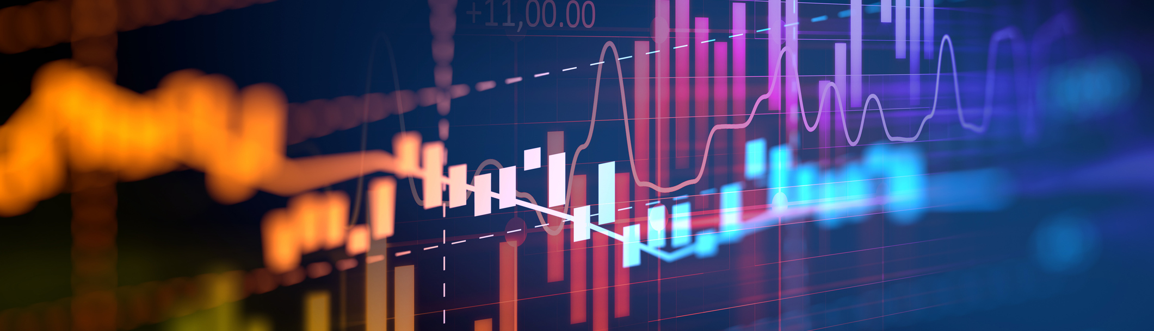
1. Introduction

Slide 4
What is machine learning?
For many problems, it's difficult to program the correct behavior by hand
recognizing people and objects
understanding human speech
Machine learning approach: program an algorithm to automatically learn from data, or from experience. Why might you want to use a learning algorithm?
hard to code up a solution by hand (e.g. vision, speech)
system needs to adapt to a changing environment (e.g. spam detection)
want the system to perform better than the human programmers

Slide 5
What is machine learning?
It's similar to statistics...
Both fields try to uncover patterns in data
Both fields draw heavily on calculus, probability, and linear algebra, and share many of the same core algorithms
But it's not statistics!
Stats is more concerned with helping scientists and policymakers draw good conclusions; ML is more concerned with building autonomous agents
Stats puts more emphasis on interpretability and mathematical rigor; ML puts more emphasis on predictive performance, scalability, and autonomy

Slide 6
Learning from data
Learning general models from a data of particular examples
Data is cheap and abundant (data warehouses, data marts);
By contrast knowledge is expensive and scarce.
Example in retail: Customer transactions to consumer behavior:
People who bought “Da Vinci Code” also bought “The Five People You Meet in Heaven”
Build a model that is a good and useful approximation to the data.

Slide 7
Data Mining / KDD
Definition := “Knowledge Discovery in Databases (KDD) is the non-trivial process of identifying valid, novel, potentially useful, and ultimately understandable patterns in data”
Applications:
Retail: Market basket analysis, Customer relationship management (CRM)
Finance: Credit scoring, fraud detection
Manufacturing: Optimization, troubleshooting
Medicine: Medical diagnosis
Telecommunications: Quality of service optimization
Bioinformatics: Motifs, alignment
Web mining: Search engines
...

Slide 8
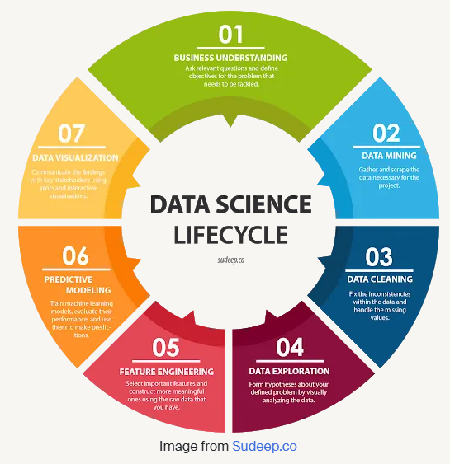
Data science lifecycle
It is all about the data!
Traditional data may come from basic customer records or historical stock price information.
Today: Big data mostly comes from the Web, for example, Facebook, Google, and LinkedIn; or financial trading data. This is the web AI (already there)
Tomorrow: machine data from sensors in industrial equipment. This is industrial AI (still to happen)
And the day after tomorrow: IoT AI (wearable tech)

Slide 9
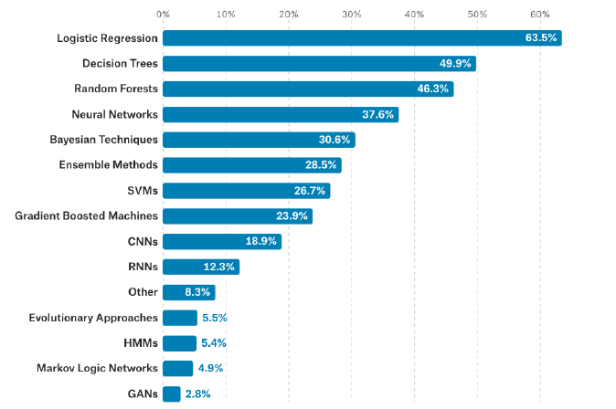
Data science methods
There are a jungle of methods
2017 Kaggle survey of data science and ML practitioners: what data science methods do you use at work?

Slide 10
Growth of machine learning
Machine learning is preferred approach to
Speech recognition, Natural language processing
Computer vision
Medical outcomes analysis
Robot control
Computational biology
Language models, Translation, report generation
This trend is accelerating
Deep learning, Large Language Models
Improved data capture, networking, faster computers
Software too complex to write by hand
Rise of autonomous systems, AI agents

Slide 11
Relations to AI
Nowadays, “machine learning" is often brought up with “artificial intelligence" (AI)
AI does not always imply a learning-based system
Symbolic reasoning
Tree search
etc.
Learning based system → learned based on the data → More flexibility, good at solving pattern recognition problems.

Slide 12
Relations to human learning
Human learning is:
Very data efficient
An entire multitasking system (vision, language, motor control, etc.)
Takes at least a few years :)
For serving specific purposes, machine learning doesn't have to look like human learning in the end.
It may borrow ideas from biological systems, e.g., neural networks.
It may perform better or worse than humans

Slide 13
Relations to classical programming
Data (Inputs)
Classical programming
Answers (Outputs)
Rules
Data (Inputs)
Machine Learning
Algorithm
Rules
Answers (Outputs)
Training/learning
Machine Learning
Model (Rules)
Data (Inputs)
Answers (Outputs)
prediction
Notes:
Predefined rules

Slide 14
2. Brief history of ML

Slide 15
History of ML
1957 - Perceptron algorithm (implemented as a circuit!)
1959 - Arthur Samuel wrote a learning-based checkers program that could defeat him
1969 - Minsky and Papert's book Perceptrons (limitations of linear models)
1980s - Some foundational ideas
Connectionist psychologists explored neural models of cognition
1984 | Leslie Valiant formalized the problem of learning as PAC learning
1988 | Backpropagation (re-)discovered by Georey Hinton and colleagues
1988 | Judea Pearl's book Probabilistic Reasoning in Intelligent Systems introduced Bayesian networks

Slide 16
History of ML
1990s - the “AI Winter", a time of pessimism and low funding
But looking back, the '90s were also sort of a golden age for MLresearch
Markov chain Monte Carlo, variational inference, kernels and support vector machines
Boosting, convolutional networks, reinforcement learning
2000s - applied AI fields (vision, NLP, etc.) adopted ML
2010s - deep learning
2010-2012 - neural nets smashed previous records in speech-to-text and object recognition
increasing adoption by the tech industry
2016 - AlphaGo defeated the human Go champion
2018-now - generating photorealistic images and videos
2020 - GPT3 transformer-based language model
2022 – ChatGPT released to public
now - increasing attention to ethical and societal implications

Slide 17
3. Types of ML

Slide 18
Types of machine learning
Types of machine learning
Supervised learning: have labeled examples of the correct behavior
Classification
Regression/Prediction
Unsupervised learning: no labeled examples - instead, looking for “interesting" patterns in the data
Clustering
Reinforcement learning: learning system (agent) interacts with the world and learns to maximize a scalar reward signal

Slide 19

Input Vectors
Machine learning algorithms need to handle lots of types of data:
images, text, audio waveforms, credit card transactions, etc.
Common strategy: represent the input as an input vector in $R^{d}$
Representation = mapping to another space that's easy to manipulate
Vectors are a great representation since we can do linear algebra!

Slide 20
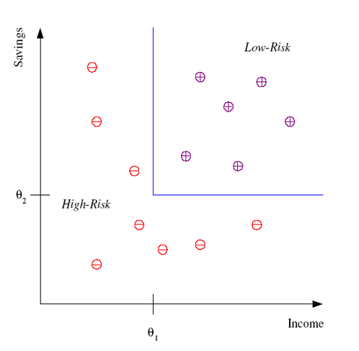
Classification (supervised learning)
Example: Credit scoring
Differentiating between low-risk and high-risk customers from their income and savings
Discriminant: IF income > θ1 AND savings > θ2
THEN low-risk, ELSE high-risk
The Discriminant here is the model
In practice many more parameters (age, profession, number of children, …) can come in

Slide 21
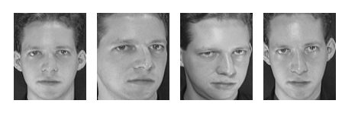
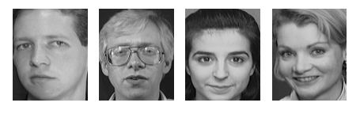
Classification (supervised learning)
Face recognition: Pose, lighting, occlusion (glasses, beard), make-up, hair style
Character recognition: Different handwriting styles.
Speech recognition: Temporal dependency.
Sensor fusion: Combine multiple modalities; eg, visual (lip image) and acoustic for speech
Medical diagnosis: From symptoms to illnesses
AT&T Laboratories, Cambridge UK
http://www.uk.research.att.com/facedatabase.html
Test images

Slide 22
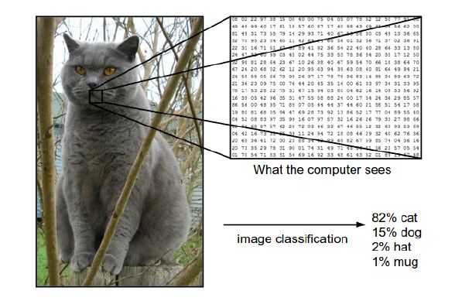
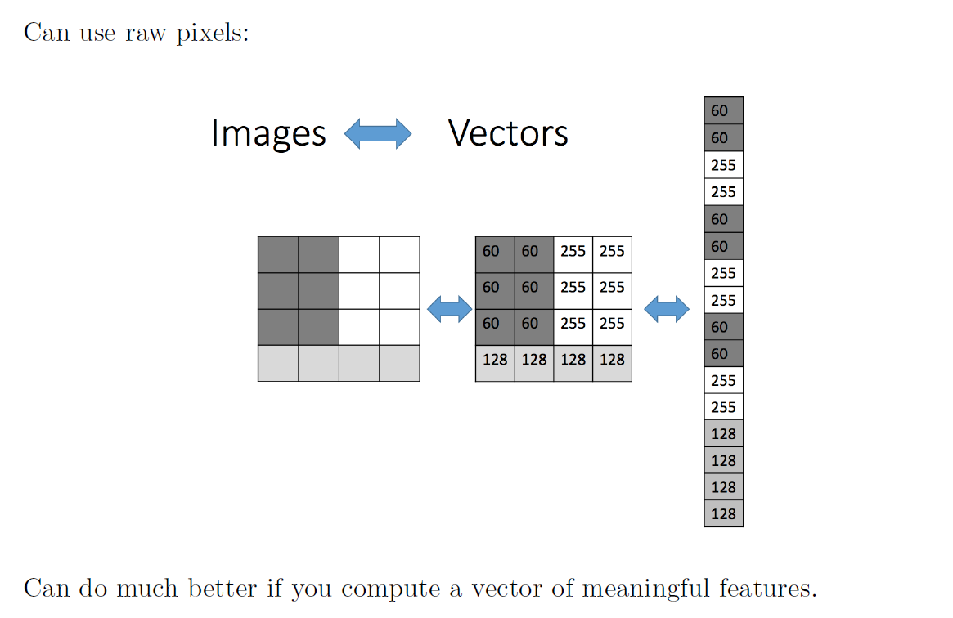
Object recognition (supervised learning)
What an image looks like to the computer:

Slide 23
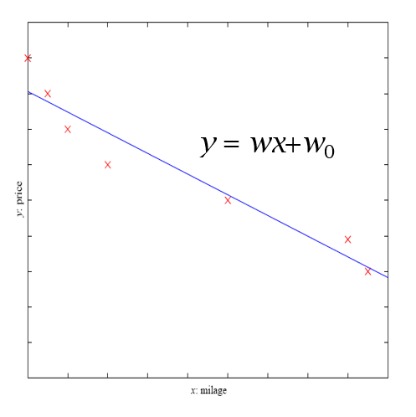
Regression (supervised learning)
Example: Price of a second-hand car
x : car attributes
y : price
y = g (x | θ )
g( ) model,
θ parameters

Slide 24
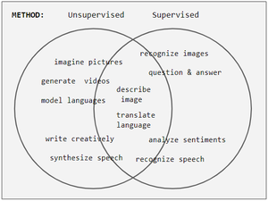
Separation not so clear
Tasks are often categorized as discriminative (recognition) or generative (imagination).
Often but not always, discriminative tasks use supervised methods and generative tasks use unsupervised
However, the separation is not always clear
For example, object recognition favors supervised learning but unsupervised learning can also cluster objects into groups
Venn diagram of ML

Slide 25
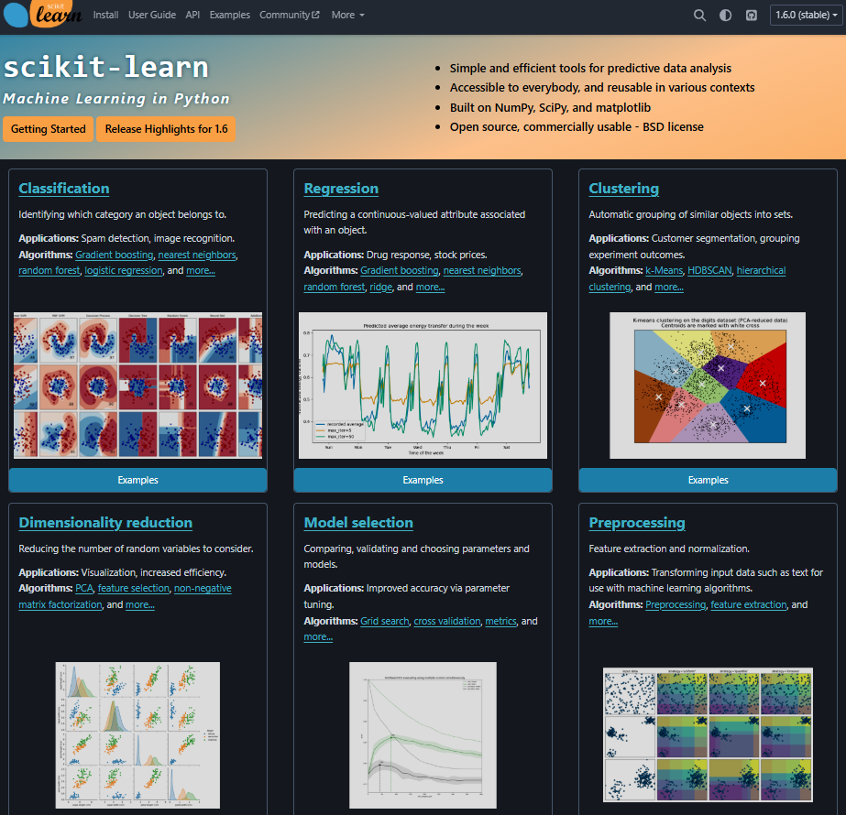
Scikit learn (all the basics)
The toolbox for python
general-purpose ML learning library, covering a wide range of algorithms and techniques: classification, regression, clustering, dimensionality reduction, and more.
Scikit-learn is designed to be user-friendly and easy to use, with a consistent API across different algorithms.
It is primarily focused on classical, non-deep learning models, such as linear regression, decision trees, random forests, …
https://scikit-learn.org/stable/

Slide 26
Unsupervised learning
Learning “what normally happens”
No output
Clustering: Grouping similar instances
Other applications: Summarization, Association Analysis
Example applications
natural language processing
image and video analysis
anomaly detection
customer segmentation
recommendation engines
…

Slide 27
4. Classification – nearest neighbor

Slide 28
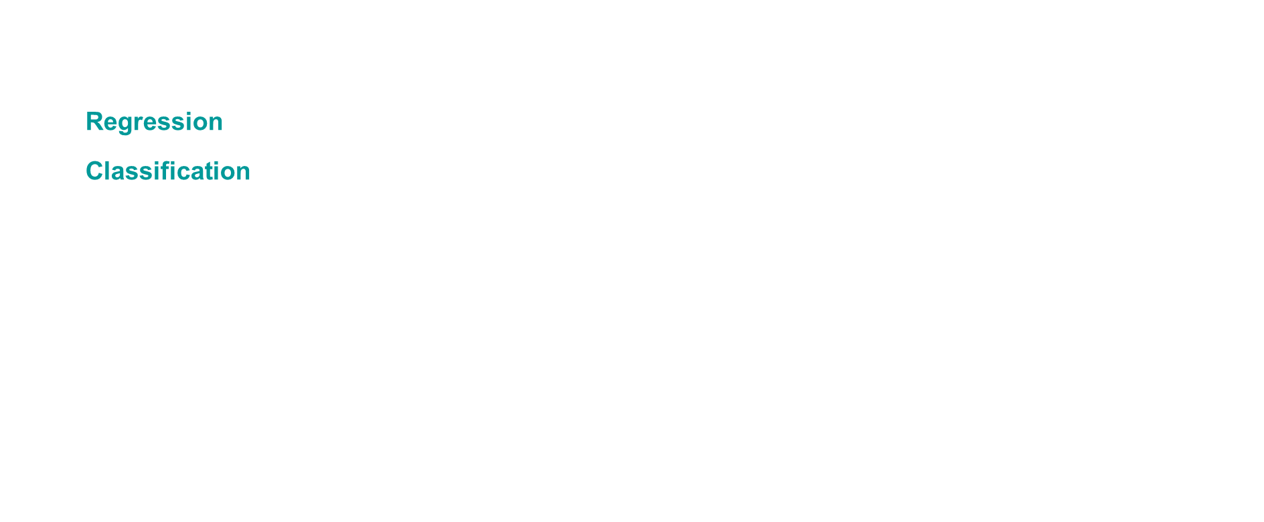
Input vectors
Mathematically, our training set consists of a collection of pairs of an input vector $x∈R^{d}$ and its corresponding target, or label, $t$
Regression: $t$ is a real number (e.g. stock price)
Classification: $t$ is an element of a discrete set $\{1,⋯,C\}$
These days, t is often a highly structured object (e.g. image)
Denote the training set $\left\{\left(x^{\left(1\right)}, t^{\left(1\right)}\right),⋯, (x^{\left(N\right)}, t^{(N)})\right\}$

Slide 29
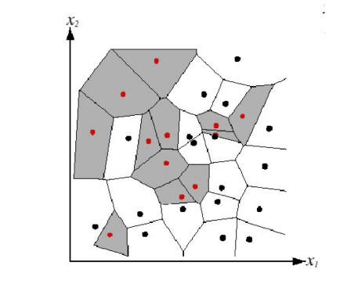
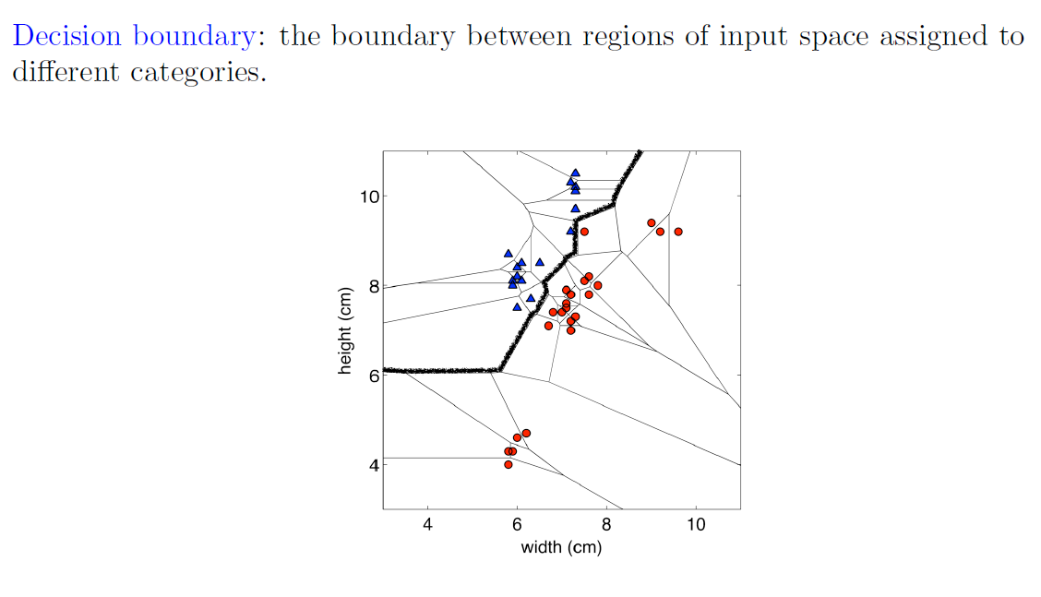

e.g. – classification - Nearest neighbors
Suppose we are given a novel input vector $x$ we’d like to classify
The idea: find the nearest input vector to $x$ in the training set and copy its label
Can formalize “nearest” in terms of Euclidean distance
$${\left|\left|x^{\left(a\right)}−x^{\left(b\right)}\right|\right|}_{2}=\sqrt{Σ_{j=1}^{d}{\left(x_{j}^{\left(a\right)}−x_{j}^{\left(b\right)}\right)}^{2}}$$
Algorithm: find $(x^{∗},t^{∗})$ (from the stored training set) closest to $x$. That is:
$$x^{∗}=argmin_{x^{(i)}∈ train. set } distance(x^{(i)},x)$$
Output: $y=t^{∗}$
We can visualize classification setting using a Voronoi diagram
Decision boundary
Notes:
*

Slide 30
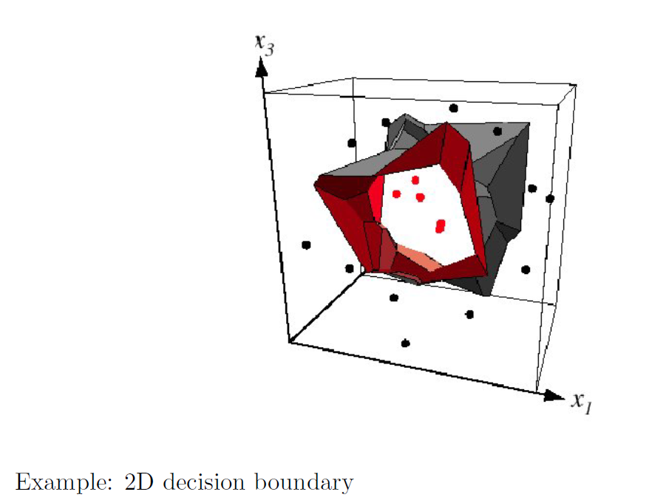
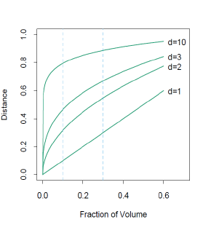
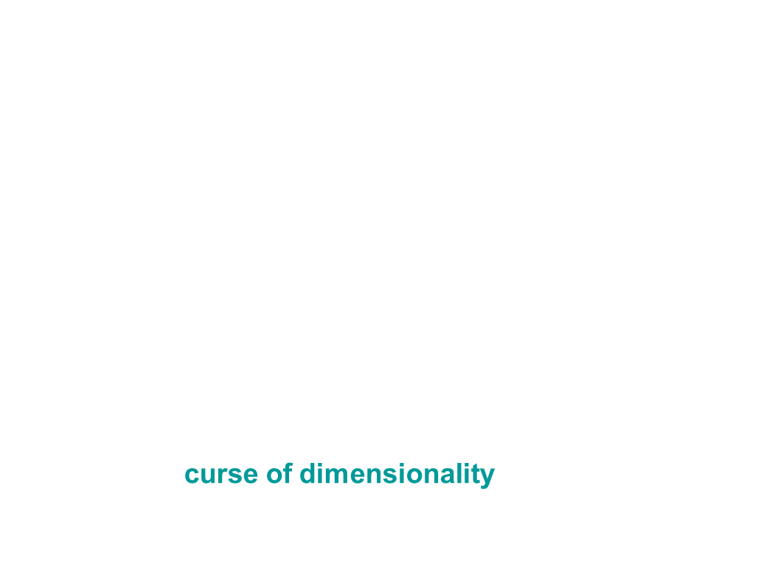

e.g. – Classification - Nearest neighbors
Low dimensional visualizations are misleading!
In high dimensions, “most” points are far apart
If we want the nearest neighbor to be closer than $ε$, how many points do we need?
The volume of a single ball of radius $ε$ is $O\left(ε^{d}\right)$
The total volume of ${\left[0,1\right]}^{d}$ is 1
Therefore $O\left({\left(\frac{1}{ε}\right)}^{d}\right)$ balls are needed to cover the volume!
This is the curse of dimensionality
Decision boundary in $R^{3}$
Curse of dimensionality

Slide 31
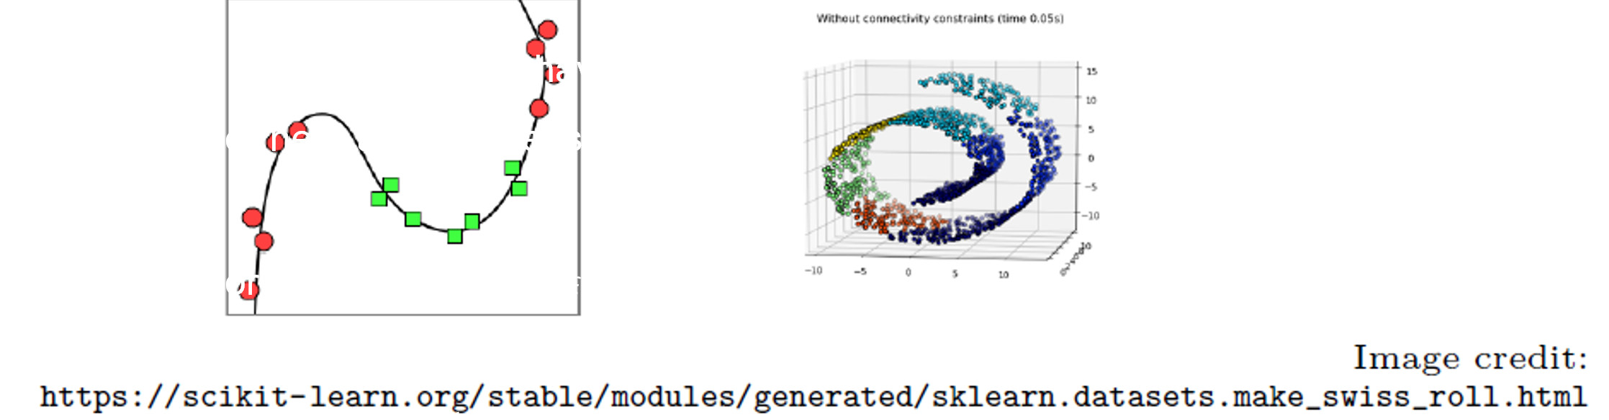
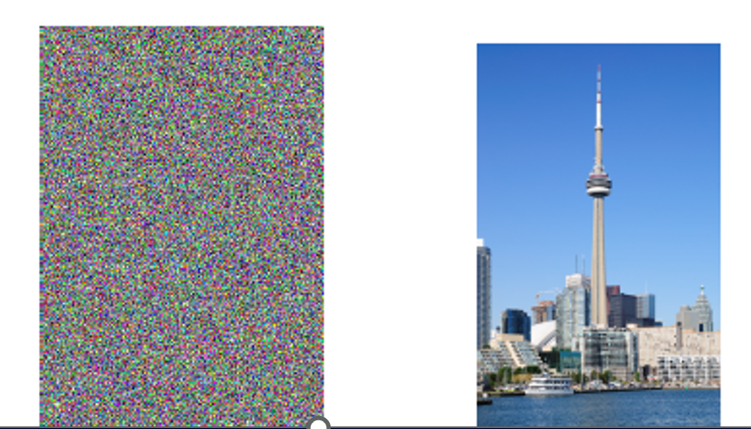
Intrinsic dimension is what matters!
Saving grace: some datasets (e.g. images may have low intrinsic dimension, i.e. lie on or near a low-dimensional manifold
The neighborhood structure and hence the curse of dimensionality depends on the intrinsic dimension
The space of pixel images below is 3-million dimensional. The intrinsic space dimension (degrees of freedom) is much smaller (there are structures/patterns)

Slide 32
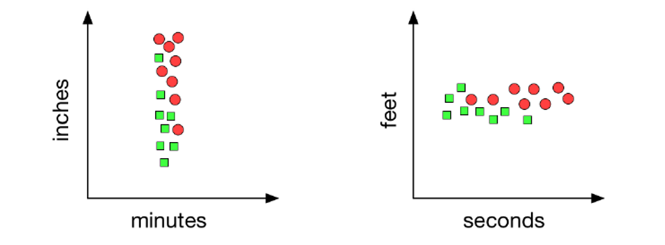
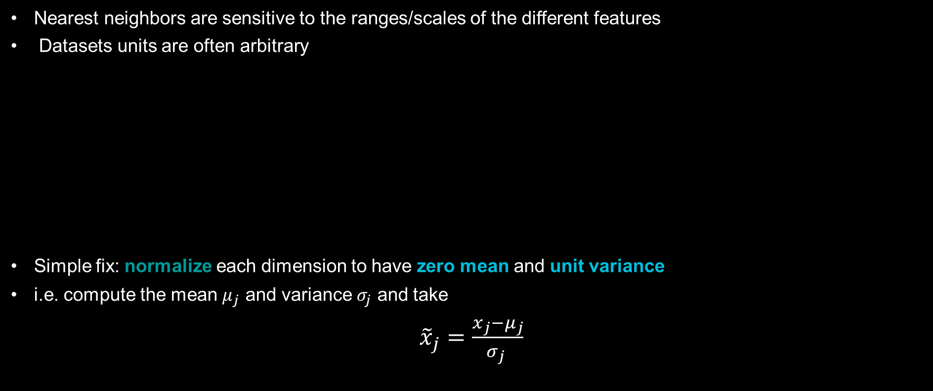
Normalization
Nearest neighbors are sensitive to the ranges/scales of the different features
Datasets units are often arbitrary
Simple fix: normalize each dimension to have zero mean and unit variance
i.e. compute the mean $μ_{j}$ and variance $σ_{j}$ and take
${\tilde{x}}_{j}=\frac{x_{j}−μ_{j}}{σ_{j} }$

Slide 33
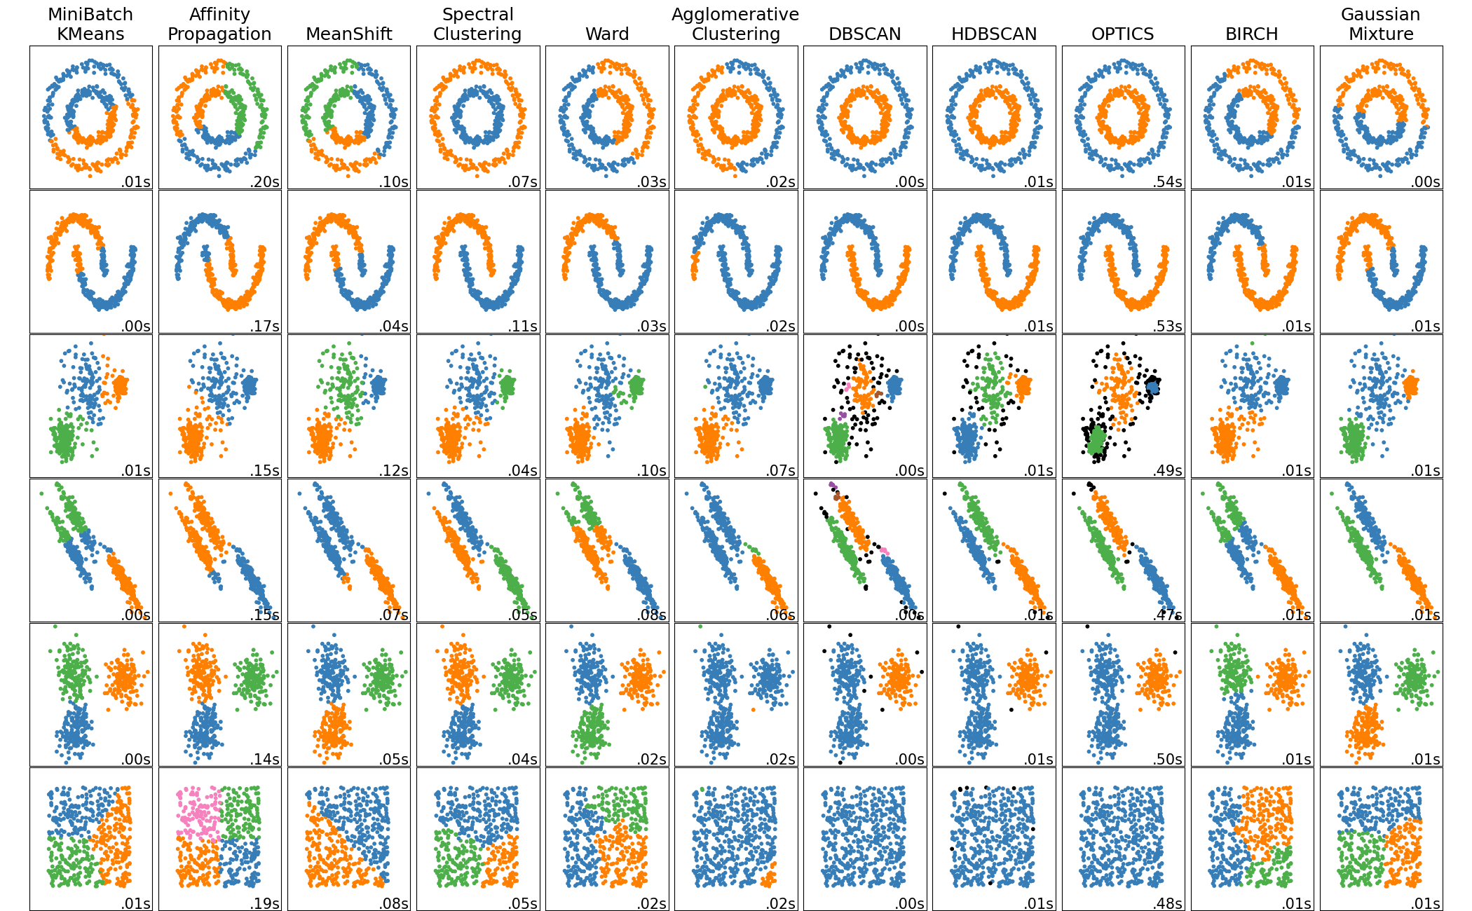
Comparing different clustering algorithms on toy datasets
From scikit-learn: This example shows characteristics of different clustering algorithms on datasets that are “interesting” but still in 2D. With the exception of the last dataset, the parameters of each of these dataset-algorithm pairs has been tuned to produce good clustering results.
The last dataset is an example of a ‘null’ situation for clustering: the data is homogeneous, and there is no good clustering.
While these examples give some intuition about the algorithms, this intuition might not apply to very high dimensional data.
https://scikit-learn.org/stable/auto_examples/cluster/plot_cluster_comparison.html

Slide 34
5. Neural networks – multilayer perceptron

Slide 35
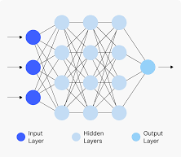
A brief overview
What is a Neural Network? A neural network is a computational model inspired by the human brain. It consists of layers of interconnected nodes, called neurons, designed to recognize patterns and make predictions.
Neurons (Nodes):
The basic units of computation in a neural network.
Organized into layers: input, hidden, and output.
Weights:
Each connection between neurons has a weight.
Weights determine the strength of the influence of one neuron on another.
Bias:
An additional parameter added to the input to adjust the output.
Helps the network model more complex relationships.
Activation Function:
Applies a non-linear transformation to the input of a neuron.
Common functions:
Sigmoid: Maps input to a range (0, 1).
ReLU (Rectified Linear Unit): Outputs max(0, x)

Slide 36
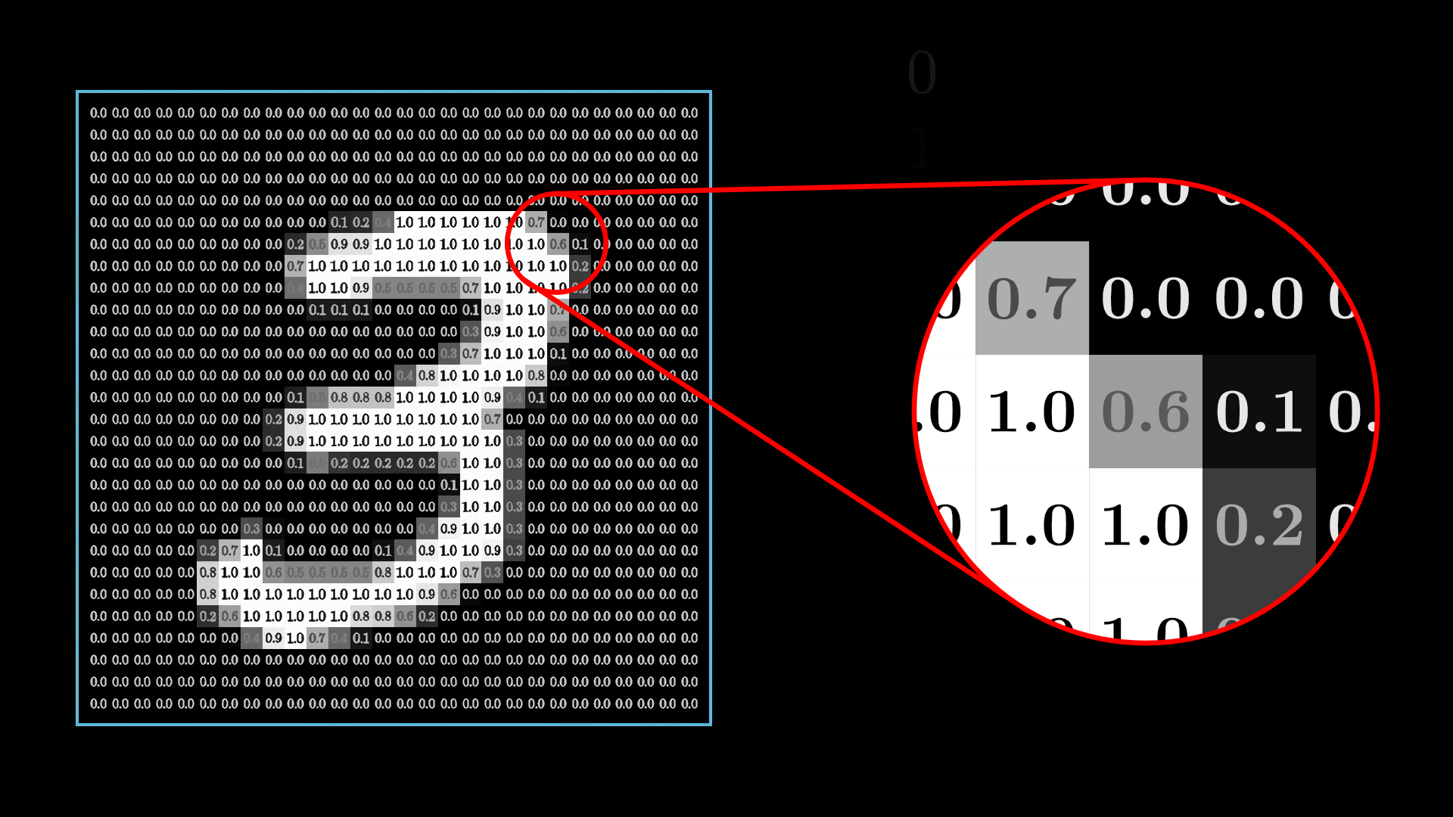
Example: Handwritten digit recognition
From https://www.3blue1brown.com/lessons/neural-networks

Slide 37


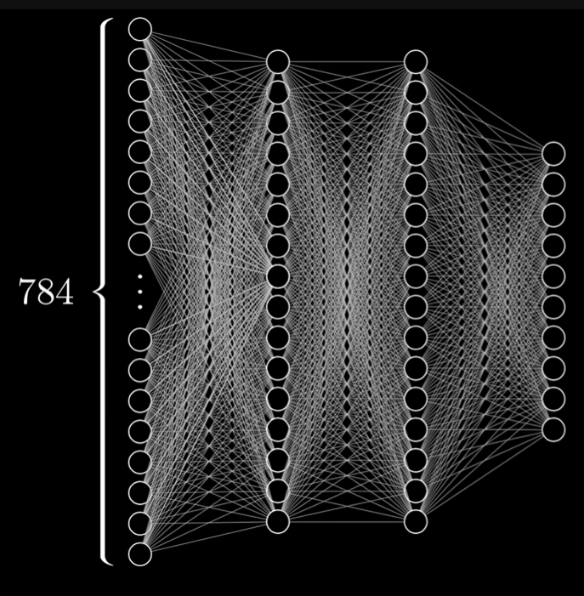
Example: Handwritten digit recognition
The “Hello World” of Neural Networks
https://www.3blue1brown.com/lessons/neural-networks
28x28 pixels with values in [0,1] (grayscale value)
Each neuron is “lit up” when close to 1
Consider the following structure (Multilayer perceptron):
Input layer = 784 neurons (one for each pixel)
Output layer = 10 neurons (0,1,2,3,4,5,6,7,8,9)
2 hidden layers of 16 neurons each (arbitrary)
Total # of parameters to train:
Each connection has a weight and each neuron has a bias
784*16 + 16*16 + 16*10 + 16 + 16 + 10 = 13 002
The output layer with largest number gives the estimated digit

Slide 38
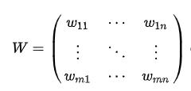
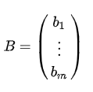
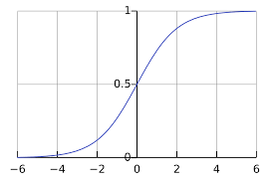
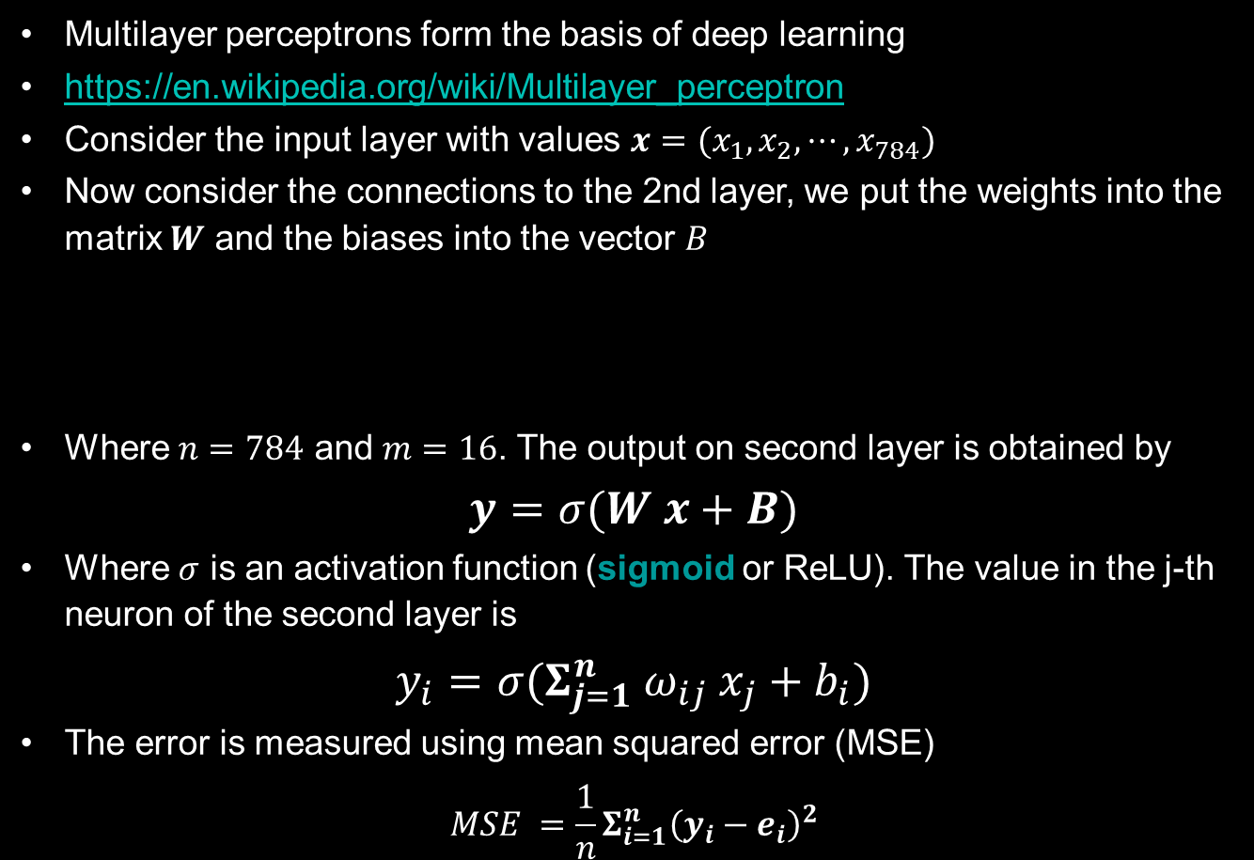
Multilayer perceptrons
Multilayer perceptrons form the basis of deep learning
https://en.wikipedia.org/wiki/Multilayer_perceptron
Consider the input layer with values $x=(x_{1}, x_{2}, ⋯, x_{784})$
Now consider the connections to the 2nd layer, we put the weights into the matrix $W$ and the biases into the vector $B$
Where $n=784$ and $m=16$. The output on second layer is obtained by
$$y=σ(W x+B)$$
Where $σ$ is an activation function (sigmoid or ReLU). The value in the j-th neuron of the second layer is
$$y_{i}=σ(Σ_{j=1}^{n} ω_{ij} x_{j}+b_{i})$$
The error is measured using mean squared error (MSE)
$$MSE =\frac{1}{n}Σ_{i=1}^{n}{\left(y_{i}−e_{i}\right)}^{2}$$
4-layer perceptron
Sigmoid activation function

Slide 39
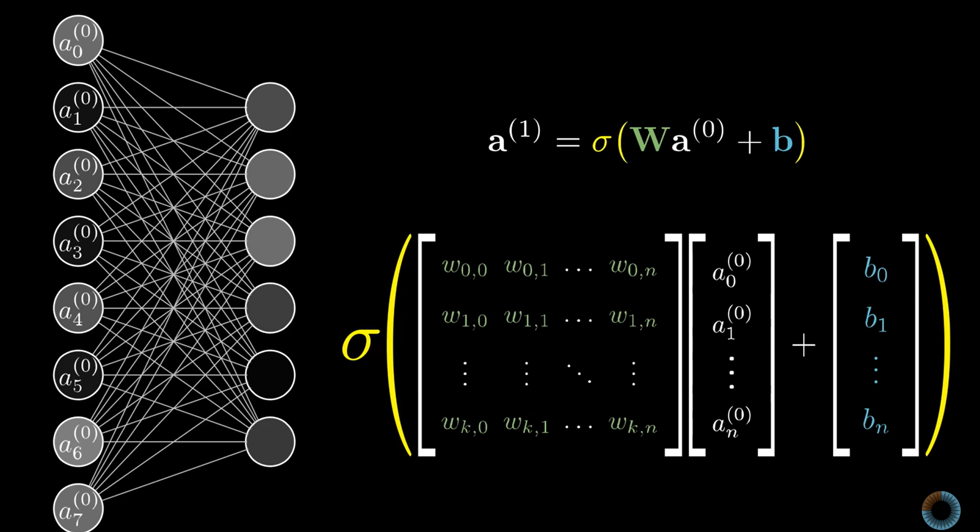

Next layer activation
Feed forward algorithm
From https://www.3blue1brown.com/lessons/neural-networks
Transition of activations from one layer to the other $a^{(i+1)}=σ\left(W_{i} a^{\left(i\right)}+b_{i}\right)$

Slide 40
Learning
You train the network with images of handwritten digits, along with labels for what they represent
Network will adjust those 13 002 weights and biases to improve performance on training data
After you trained, you test with more data not shown for training
It comes down to finding the minimum of a certain function
Reminder: Weights = strengths of the connections, Bias = Neuron is active or inactive
We start by assigning weights and biases randomly
Then we estimate the cost function, the error:
Add up the squares of the differences between the proposed output layer values and the ones you want them to have = cost of a single training example
Neural Network function
Input: 784 numbers (pixels)
Output: 10 numbers (result)
Parameters: 13002 (weights and bias)
Cost function
Input: 13002 weights and biases
Output: 1 number (the cost)
Parameters: 10 000’s

Slide 41
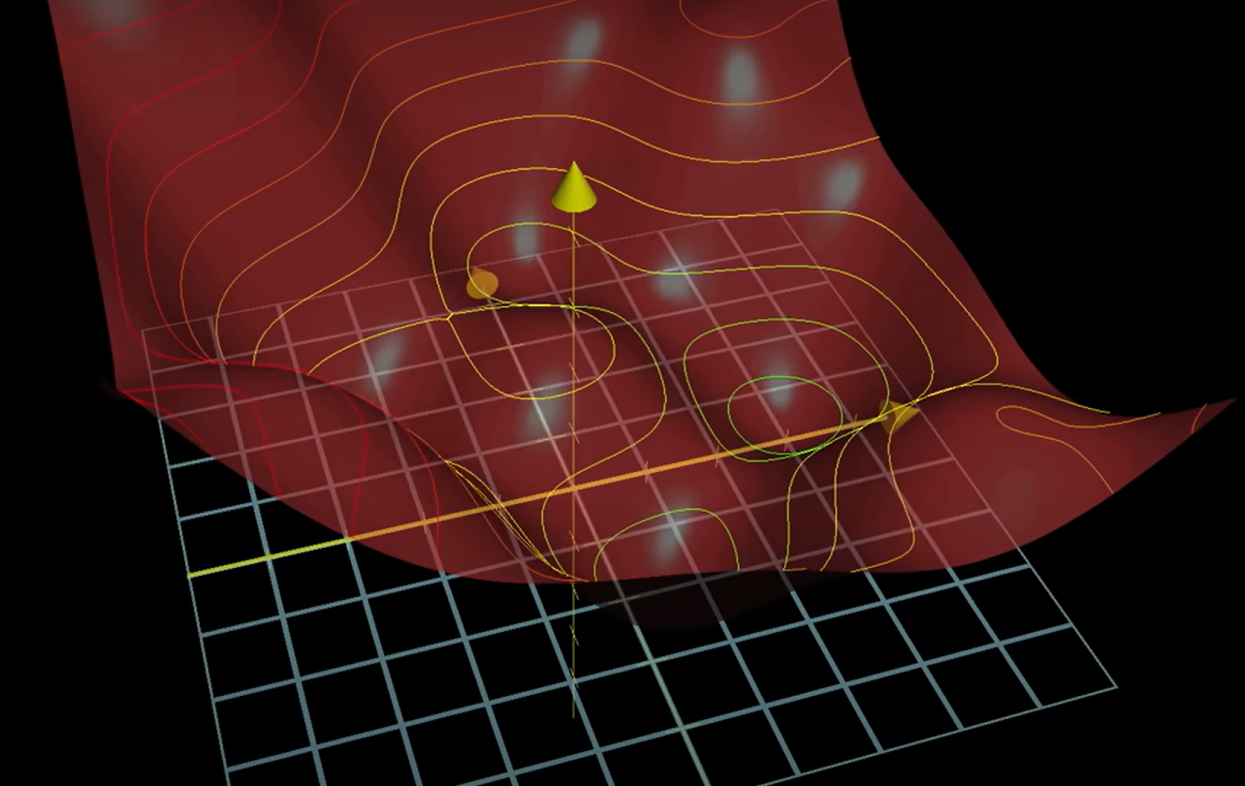
Gradient descent
Neural Network function
Input: 784 numbers (pixels)
Output: 10 numbers (result)
Parameters: 13002 (weights and bias)
The function we want to minimize, has 13002 dimensions!
We can approach a local minimum of the function using gradient descent
We go downhill the hypersurface of dimension 13002!
What is important is to ensure the smoothness of the cost function → this is why we introduce a smoothing activation function
Cost function
Input: 13002 weights and biases
Output: 1 number (the cost)
Parameters: 10 000’s

Slide 42
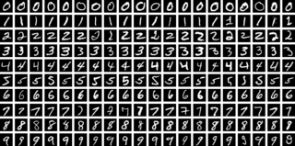
Training data
https://en.wikipedia.org/wiki/MNIST_database
60,000 training images and 10,000 testing images
Labeled (exact label is available)
Error rates down to <0.1% ( "human performance“)

Slide 43
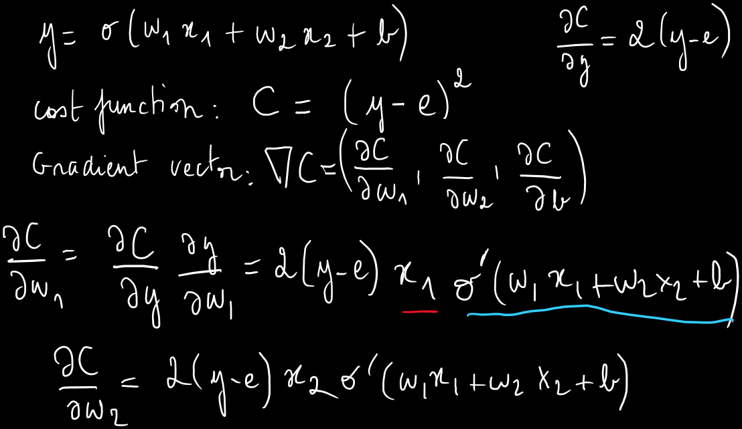
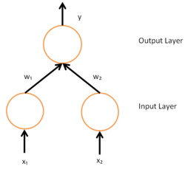



Back propagation
So how do we compute the gradient?
How do we find the delta to all the weights and biases to most efficiently decrease the cost function?
The algorithm to compute the gradient of the cost function is called back propagation
Consider the simple network:

Slide 44
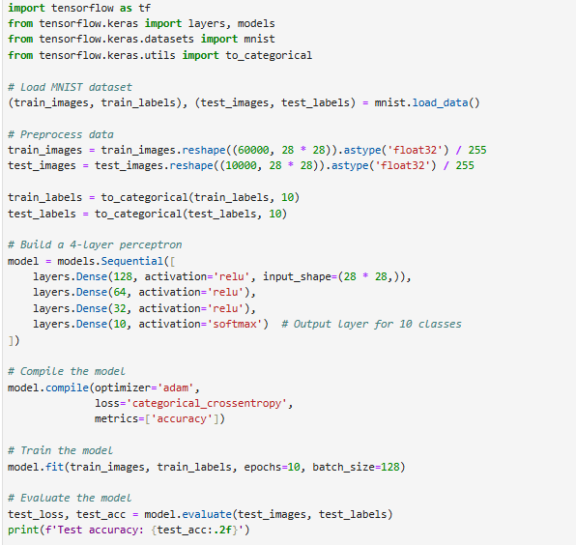
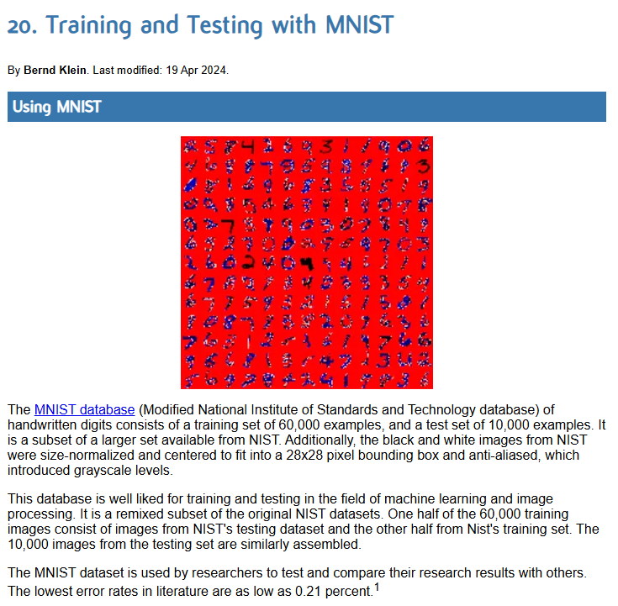
MNIST example
https://python-course.eu/machine-learning/training-and-testing-with-mnist.php

Slide 45
6. Summary

Slide 46
Summary
Machine learning is becoming a classical tool for engineers, and comes in complement to traditional programming, when rules or logic cannot be defined a-priori
It requires vast amount of data, and consists in two steps, training and inference
Supervised training requires labeling the data a-priori, unsupervised training finds associations
For classification, nearest neighbor is based on minimizing Euclidean distance in large dimensional spaces. While spaces are of high dimension, data can often be represented in a lower dim. space
For more complex tasks (e.g. shape recognition), Neural Networks, like Multilayer Perceptrons may be needed.
It requires a structure of layered neurons with activation functions and biases, fed forward through weighted connections
A cost function, including all weights and biases is minimized during Back-propagation using a simple gradient descent

